Slide 1
Automated Gear and Shaft Analysis
Ricardo Ochoa (ME), Zhidong Ju (ME)
Advisors: David C. Brown (CS) , Pradeep Radhakrishnan (ME,RBE)

Slide 2
Gear Analysis
Gear Types
Dimensions
Kinematics
Stress Factors
Gear-tooth Bending and Surface Stresses
Corrected Fatigue Strengths
Safety Factors

Slide 3

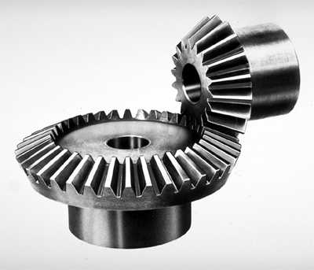
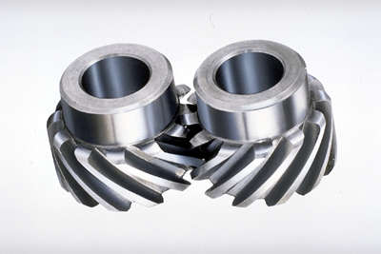
Gear Types
Spur
Bevel
Helical
How Gears Work – by Karim Nice https://science.howstuffworks.com/transport/engines-equipment/gear4.htm
Notes:
Pictures of each gear type

Slide 4
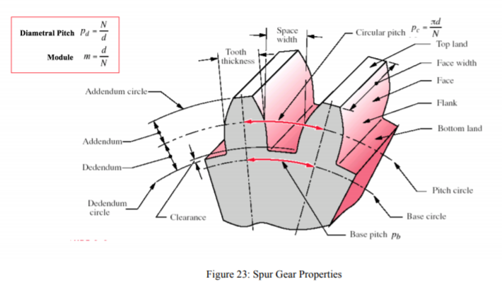
Gear Dimensions and Kinematics
Dimensions
Diametral Pitch
Addendum
Pitch Diameter/Radius
Radius of Curvature
Pressure, Helical, and Cone Angles
Kinematics
Torque and Angular Velocity
Tangential Force and Velocity
Normal/Radial and Axial Forces
Notes:
Pictures showing gear dimensions and force/velocity vectors acting on gear

Slide 5
Stress Factors
Dynamic Factor
Application Factor
Bending and Surface Geometry Factor
Notes:
Equations/Tables of the main stress factors listed

Slide 6
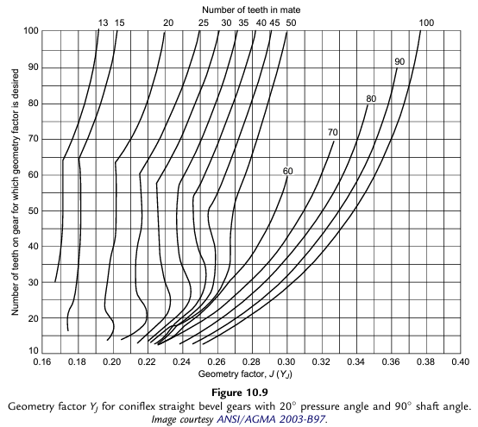
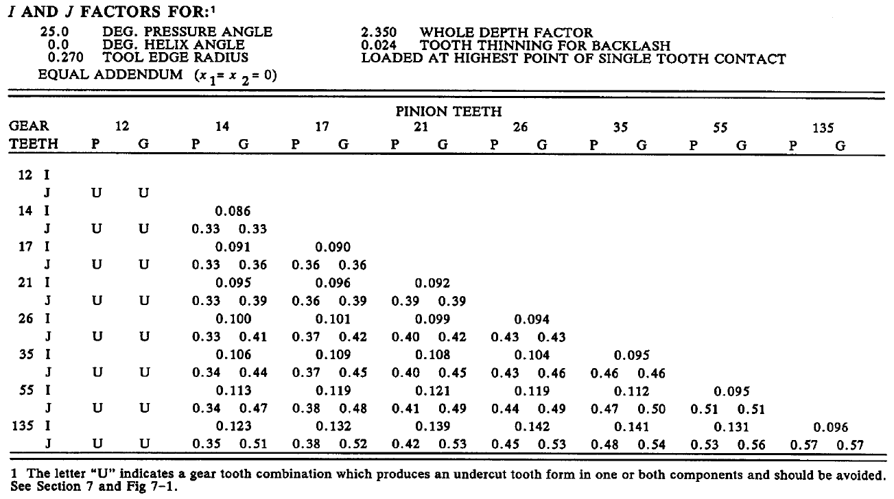
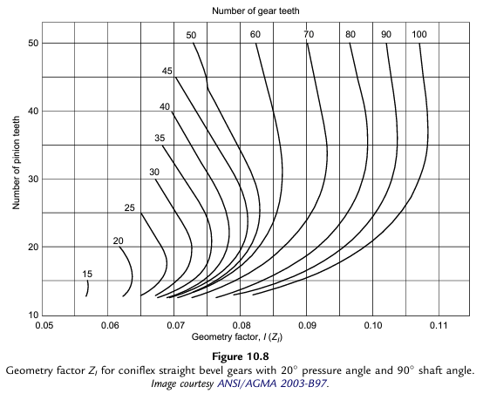
Bending and Surface Geometry Factors

Slide 7

Gear-Tooth Bending and Surface Stresses
Bending Stress:
$σ_{b}=\frac{W_{t}∗P_{d}∗K_{a}∗K_{m}∗K_{I}}{F∗J∗K_{V}}$
Surface Stress:
$σ_{c}=C_{p}∗\sqrt{\frac{W_{t}∗C_{a}∗C_{m}}{F∗I∗d∗C_{V}}}$
$where d=D_{pp} if D_{pp}<D_{pg}$; otherwise, $d=D_{pg}$

Slide 8

Corrected Fatigue Strengths
Corrected Bending Fatigue Strength:
$S_{fb}=\frac{K_{L}∗S_{fb}^{′}}{K_{R}}$
Corrected Surface Fatigue Strength:
$S_{fc}=\frac{C_{L}∗S_{fc}^{′}}{C_{R}}$

Slide 9

Safety Factors
Bending Safety Factor:
$N_{b}=\frac{S_{fb}}{σ_{b}}$
Surface Safety Factor:
$N_{c}=\frac{S_{fc}}{σ_{c}}$

Slide 10
Shaft Analysis
Gear and Bearing Locations
Force Locations and Directions
Shaft Loading Arrangements
Reactions at Bearings
Moments and Deflections at Gears
Method of Superposition

